Slide 1
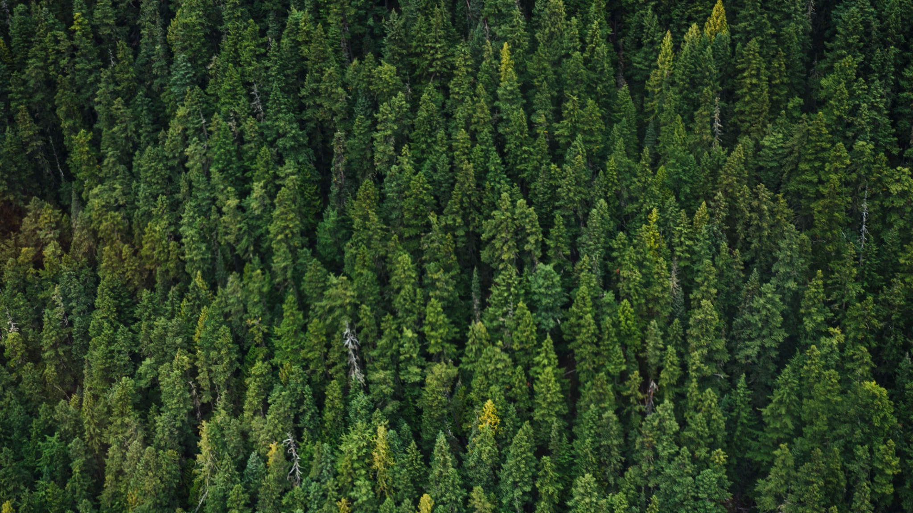
Vrikshnetra
A Major Project Presentation
Pradyumna Rajnekar (EN21CS301561)
Prateek Patidar (EN21CS301574)

Slide 2
Vrikshnetra : Medicinal Plant Identification
Key for nature enthusiasts/botanists/herbal medicine practitioners.
Existing platforms lack accuracy, structure, and category-based filtering.
Challenges in Existing Platforms:
Misidentifications and incorrect data.
Lack of a structured approach for plant discovery.
Absence of category-based filtering to aid exploration.
Limited focus on specific regional plants, leading to reduced relevance.

Slide 3
Existing Platforms & Their Limitations (Lit. Review)
PlantSnap: Lacks clear categorization.
LeafSnap: Struggles with lesser-known species.
PictureThis: Basic recognition, no category-based filtering.
Flora Incognita: No category-based filtering.
iNaturalist: Global focus, lacks regional plant emphasis.
Vrikshnetra 's Advantage: Provides real-time identification, CNN-based accuracy, category-based organization, and regional plant focus.

Slide 4
Objectives
Real-Time Identification: Allow users to upload images and get quick results using a CNN-based model.
Accuracy & Reliability: Improve identification accuracy, particularly for Indian plant species.
Category-Based Filtering: Provide structured plant exploration by categories (e.g., medicinal, flowering plants).
Scalable & Secure Platform: Build a robust system with frontend (HTML/CSS) and backend (CNN model) for large user traffic.
Seamless User Experience: Smooth image uploads for easy user interaction.

Slide 5
Methodology
Step 1: Requirements Gathering:
Conduct surveys and interviews to understand user expectations (speed, accuracy, ease of use).
Define primary requirements: plant image uploads, real-time species detection, user-friendly interface.
Step 2: UI/UX Design (Frontend):
Simple HTML structure for easy image uploads.
Responsive and modern CSS design (using Flexbox or Grid).
Clean image upload interface and result display in card-like/modal layout.

Slide 6
Methodology
Step 3: Development:
Frontend: HTML/CSS + JavaScript for the user interface and interactions.
Backend: Python-based CNN model using TensorFlow, Keras, or PyTorch.
Image Processing: JavaScript sends the image to the backend for identification.
Step 4: Testing & Deployment:
Test model accuracy with various plant species.
Perform system testing for image uploads and interaction with the backend.
Deploy on a cloud platform (AWS or Heroku) and maintain with CI/CD pipelines.

Slide 7
Conclusion & Future Work
Conclusion:
Vrikshnetra offers an innovative, structured, and accurate plant identification solution.
Focused on real-time identification, accuracy, and a seamless user experience.
Future Work:
Expand the database with more plant species.
Include additional features such as community engagement and plant care tips.

Slide 8
Thank You
See Ya till next time

Slide 9
Presentation 2

Slide 10
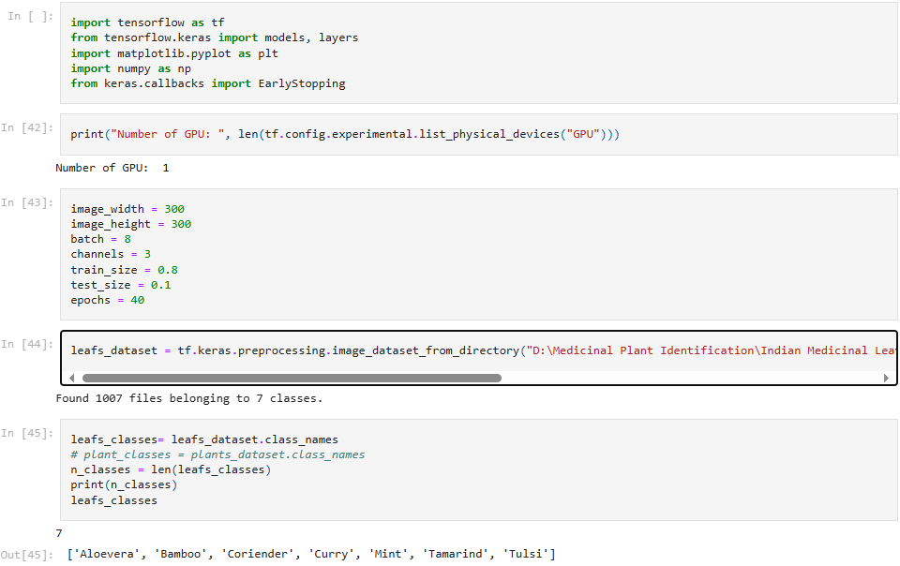

Slide 11
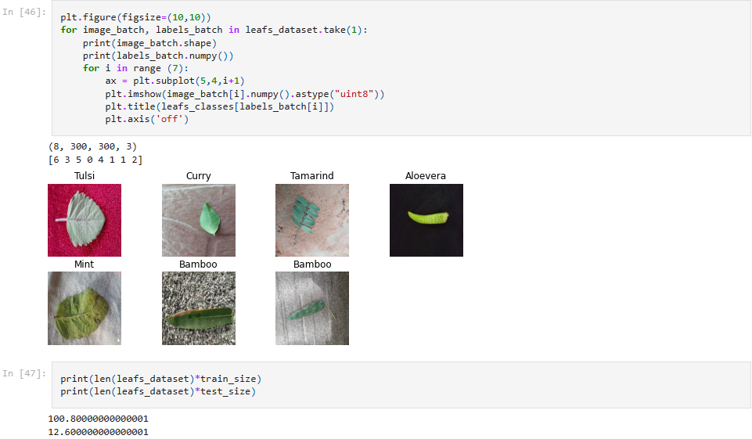

Slide 12
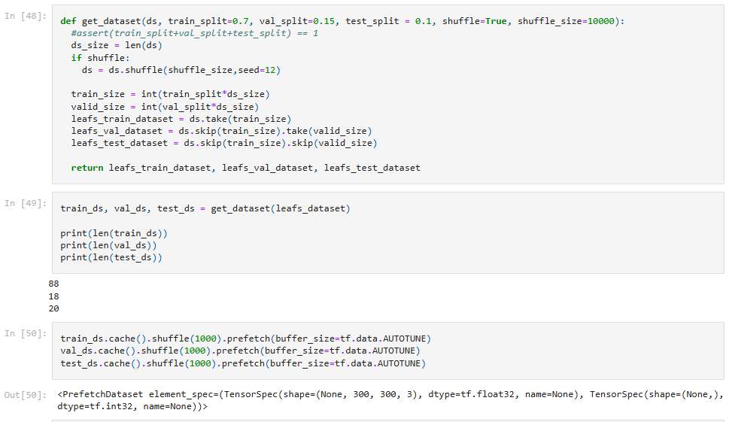

Slide 13
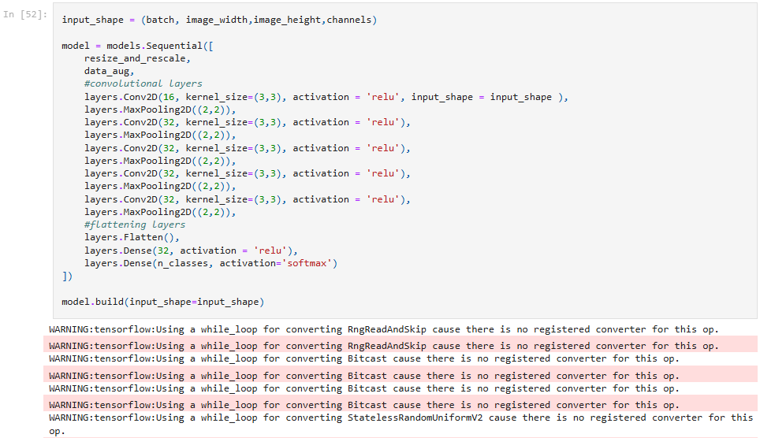

Slide 14
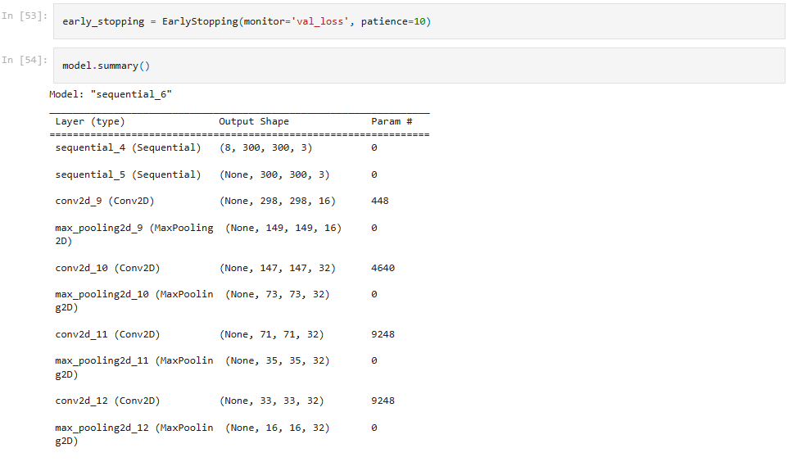

Slide 15
